Slide 1

ANALYSIS OF HOUSES IN UNITED STATE
MID-TERM PROJECT USING REGRESSION
By Agnes Samson

Slide 2

CONTENTS
INTRODUCTION
PROCESSES
INSIGHTS
THE RESULTS

Slide 3
INTRODUCTION
The dataset consists of information on 22,000 properties. The dataset consists of historic data of houses sold between May 2014 to May 2015.
Exploring the characteristics of the houses using business intelligence tools.
Building a model that will predict the price of a house based on features provided in the dataset.
Understanding which factors are responsible for higher property value - $650K and above.

Slide 4





PROCESSES

Slide 5
Processes
DATA CLEANING nulls, duplicates, Error
EXPLORE THE DATA analyse columns
EDA
plots , visualisation
MODEL
linear regression, KNN model
DATA WRANGLING normolizer, scaler

Slide 6
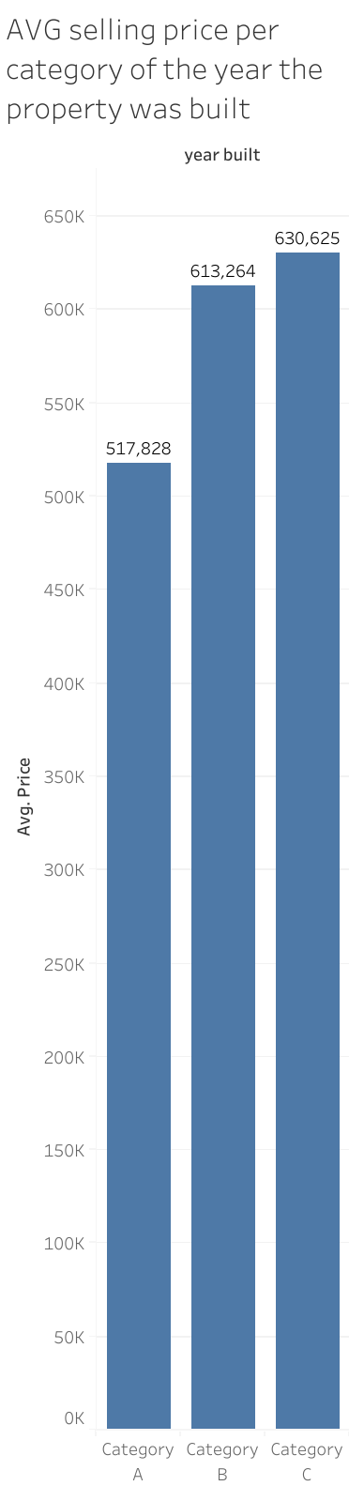
INSIGHTS
New houses are more expensive.
Zip code 98039 is extreme expensive with avg Price-$ 2,161,300
The Price is correlated with grade and living area of the house.
Most wanted houses are: 3 bedrooms, followed by 4 bedrooms.

Slide 7
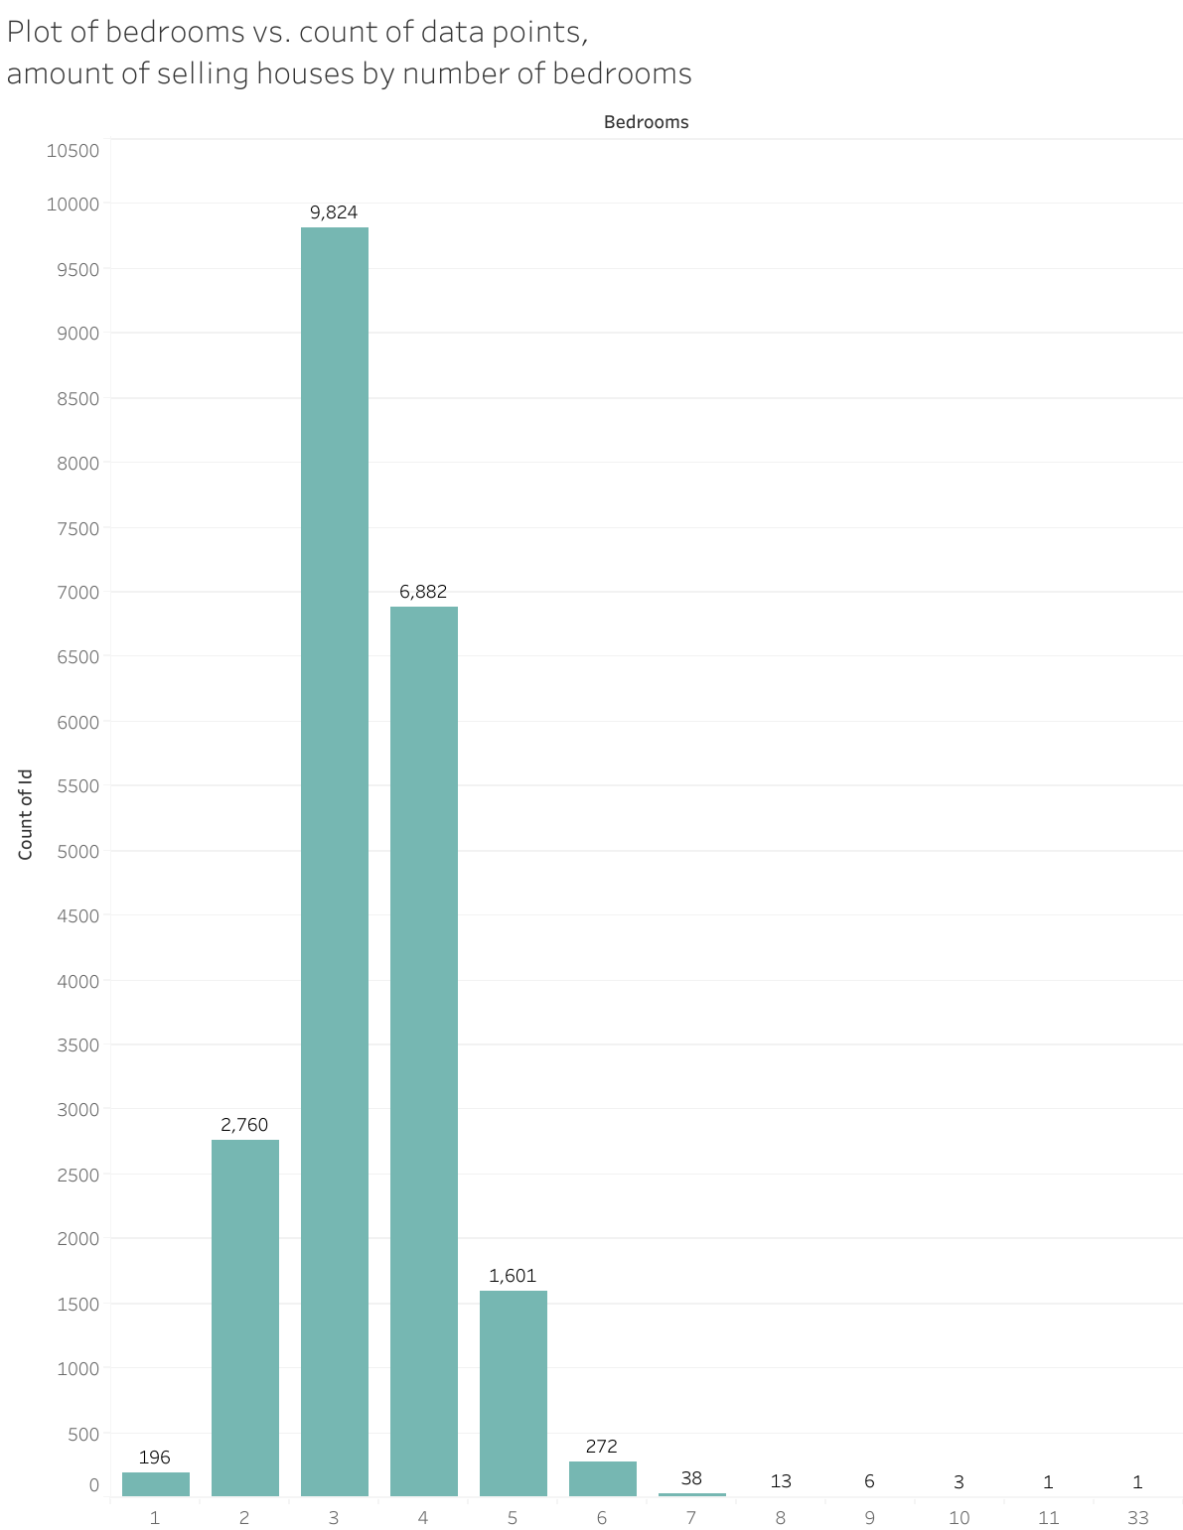
Number of houses sold by number of bedrooms
3 Bedrooms are Most popular houses
4 bedrooms
2 bedrooms
5 bedrooms
6 bedrooms
1 bedrooms

Slide 8
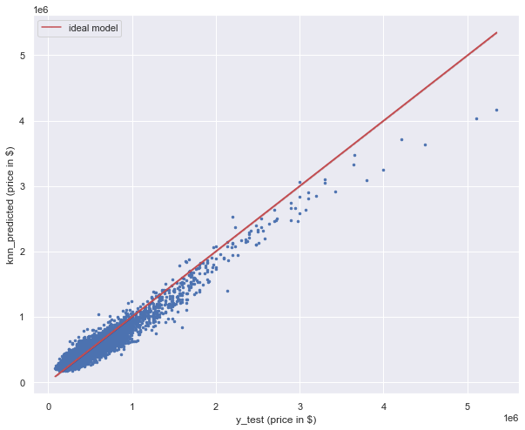
KNN Model KNN or K-Nearest Neighbor works on Euclidean distance between the neighbor cordinates X and y to know how similar data is.
R2: 0.9127457443925724 MSE: 11713090532.524797 RMSE: 108227.03235571415 MAE: 78370.17731481482
The R2 of the KNN model is around 91% with a mean absolute error of 78370 $, so this model performs better than the linear regression we did before.

Slide 9


